Slide 1

Front main 1

Slide 2

Front main 2

Slide 3

Front main 3

Slide 4

Front main 4

Slide 5
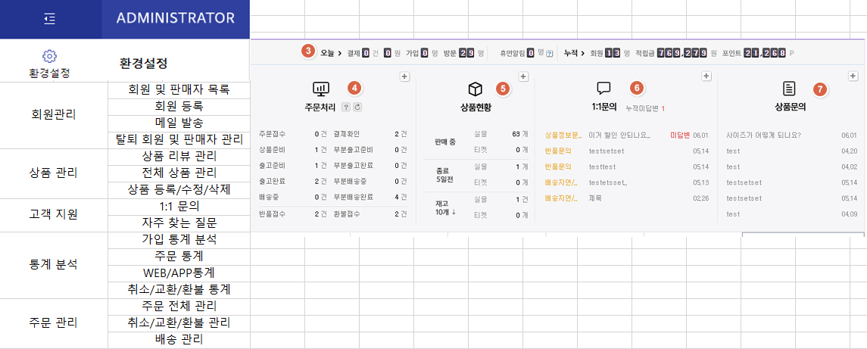
Backend main

